Slide 1
Creating a KPI
In the Control Panel

Slide 2
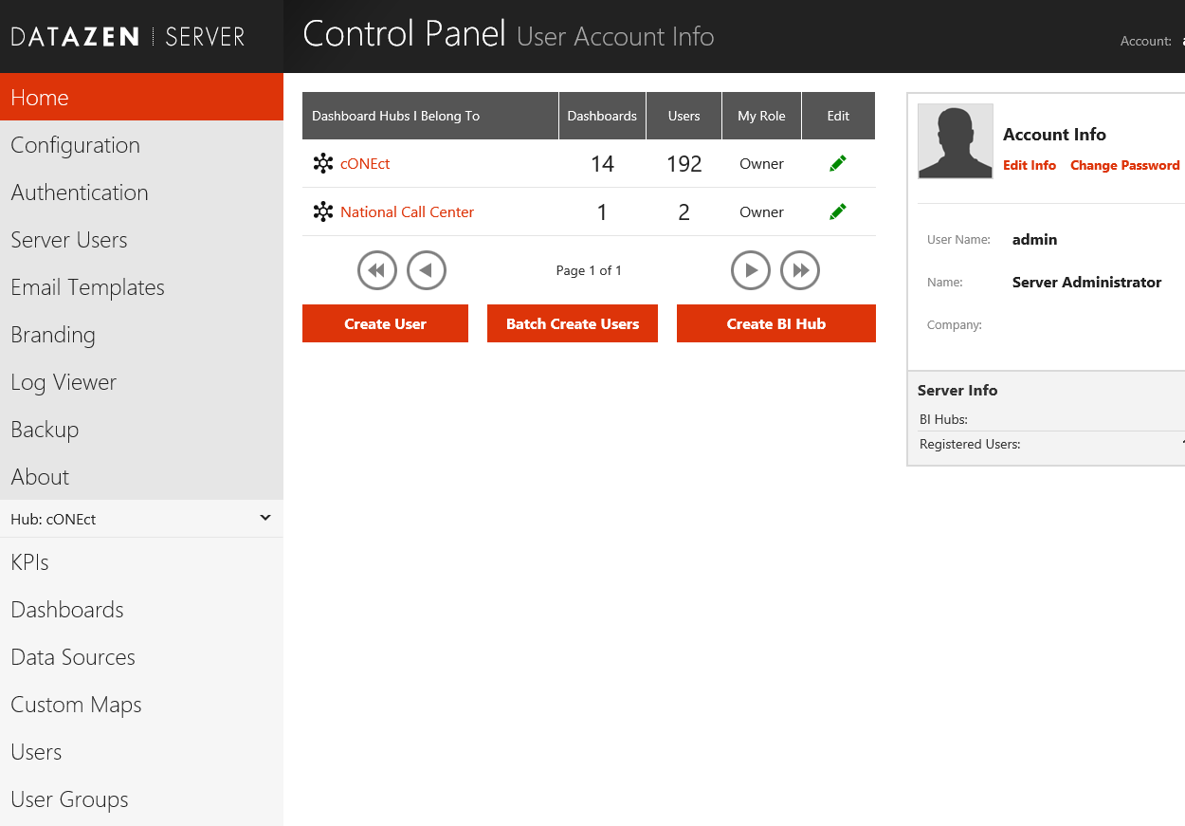
This is the Home page of the Control Panel. Click on KPIs to get started.

Slide 3
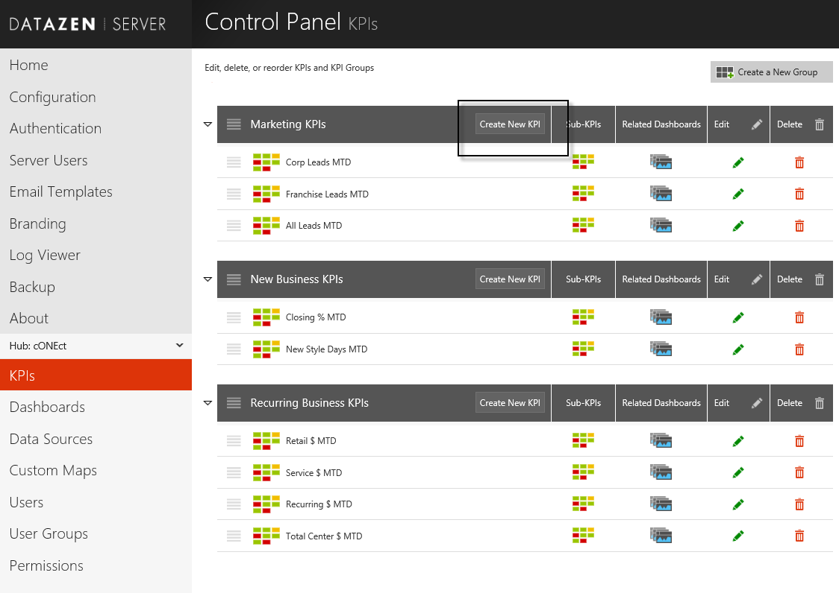
Then click on Create New KPI

Slide 4
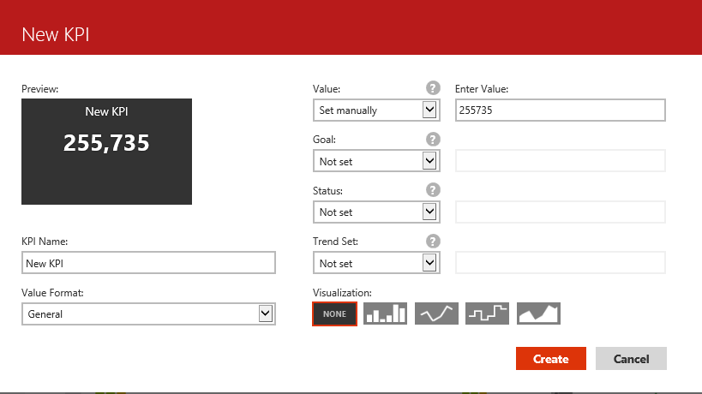
You can set each Value either manually or with a query – We will do the query.

Slide 5
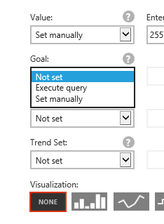
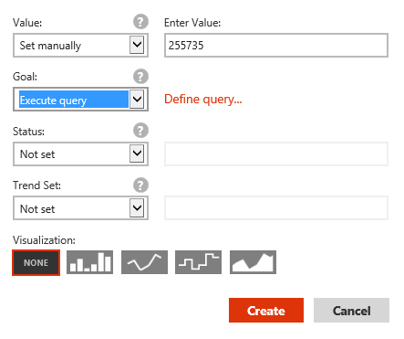
There are four queries to define: Value, Goal, Status and Trend. Under each of these you will need to select “Not set”, “Execute query” or “Set manually”. In this example, we will select “Execute query”.

Slide 6
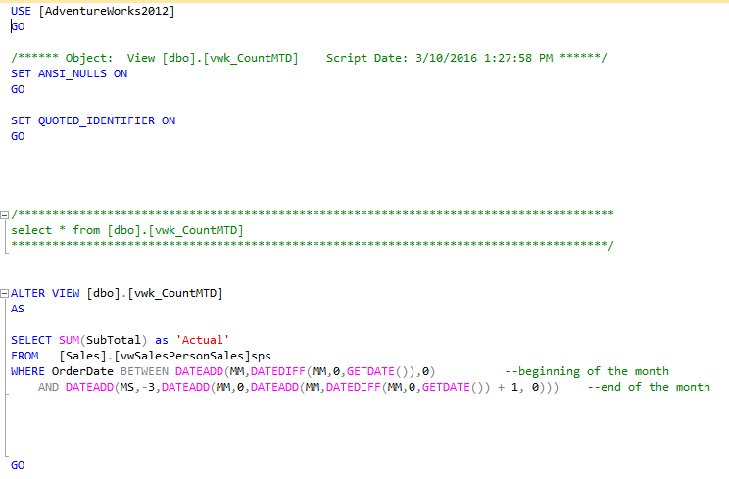
We will write four views to define each of these – Value (Actual), Goal(Budget), Status and Trend.
Value:

Slide 7
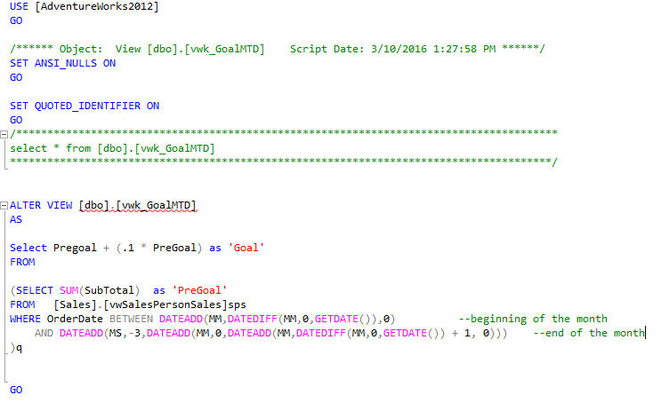
Goal:

Slide 8
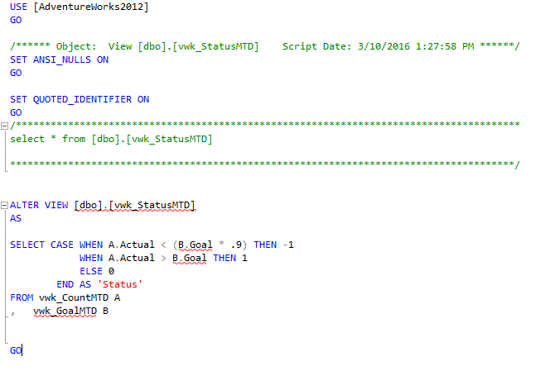
Status:

Slide 9
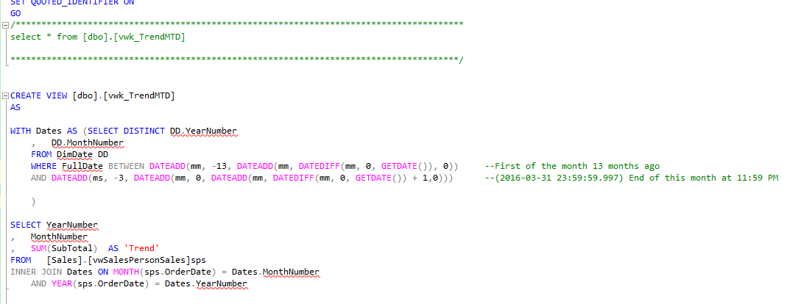
Trend:

Slide 10
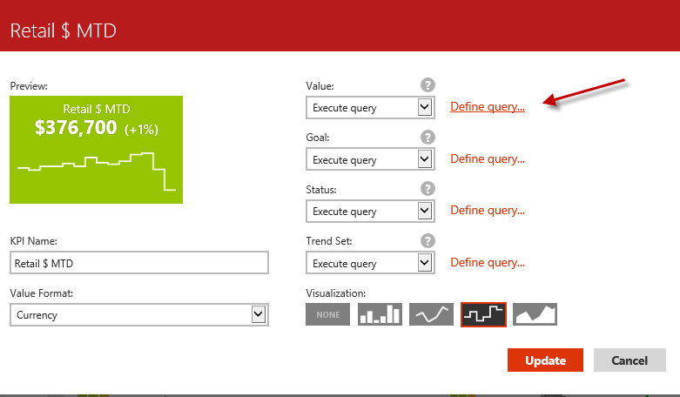
Click on Define query

Slide 11
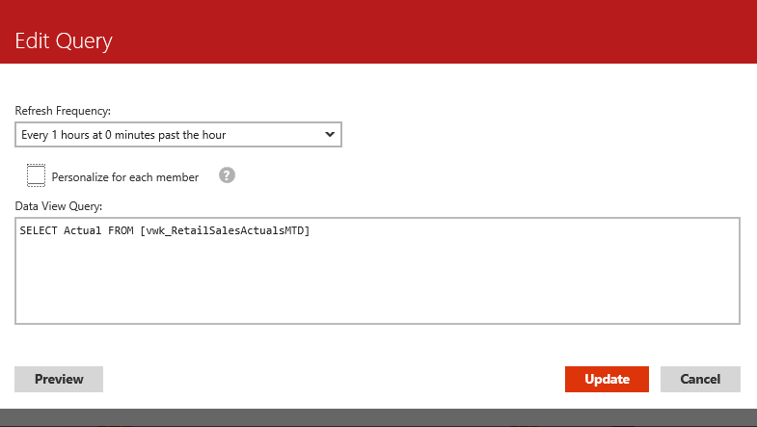

Slide 12
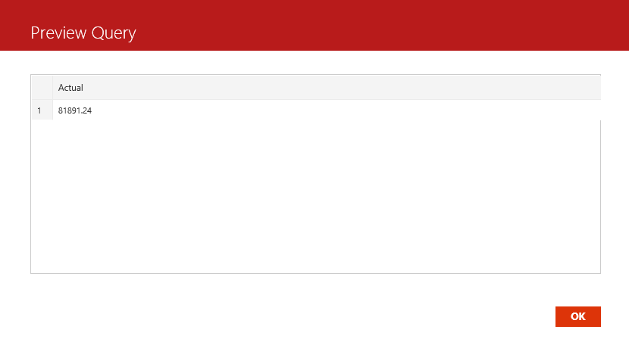

Slide 13
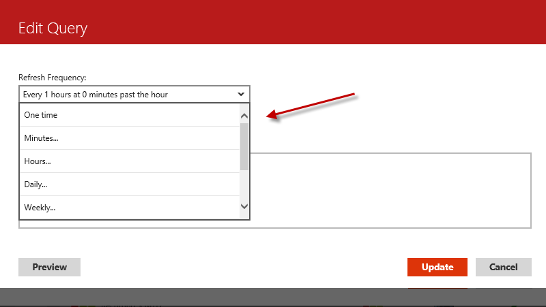
Set up how often you would like the data to refresh

Slide 14
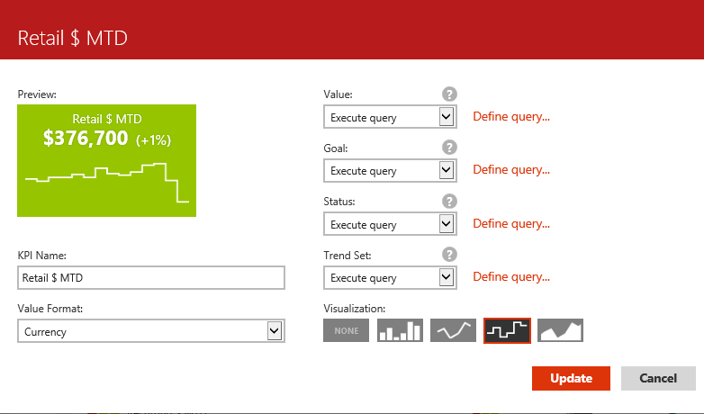
Type the name of your KPI
Select the visualization
Choose the format
Click on Update and you can see your KPI under Preview

Slide 15
The KPIs will show up on the Main Page of Datazen. Click on each thumbprint to see the KPI individually.

